Slide 1

User Management System
Mohammed Dandoti
Naveen Narayanappa
Ravi Sinha
Dhrubajyoti Bharali
Dhirendra Singh
Sofia Roman
Prachi Diwakar

Slide 2
Roles Assigned
Mohammed Dandoti Backend
Dhrubajyoti Bharali Backend, Frontend
Dhirendra Singh Frontend
Sofia Roman Backend
Prachi Diwakar Frontend
Ravi Sinha Database (My SQL)
Naveen Narayanappa Database (My SQL)

Slide 3

Contents:
Introduction
Scope
Technologies used
Screenshots

Slide 4

Scope
It allows Admin to manage user access and control user accounts.

Slide 5

Introduction
User management describes the ability for administrators to manage user access .
User management is a core part to any identity and access management (IAM) solution, in particular directory services tools.
Controlling and managing user access to IT resources is a fundamental security essential for any organization.

Slide 6
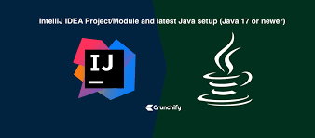


Technologies Used
Springboot
Thymeleaf
MY SQL
Intellij
Apache Maven
Java
Git and GitHub

Slide 7
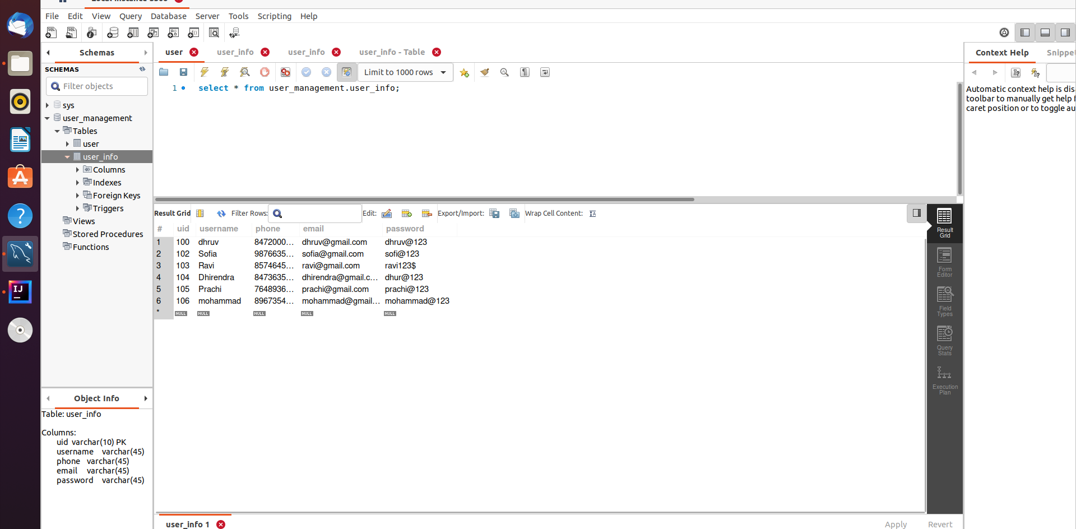
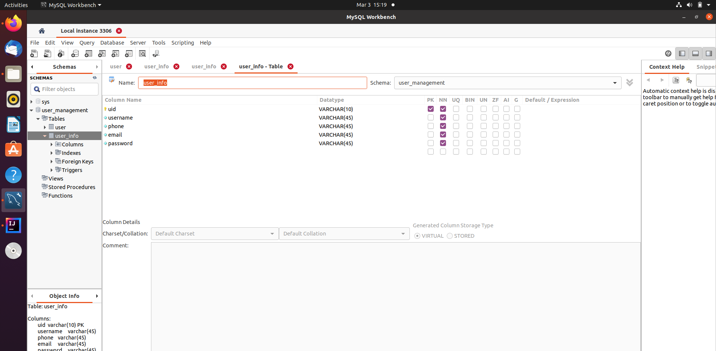
Screenshots

Slide 8
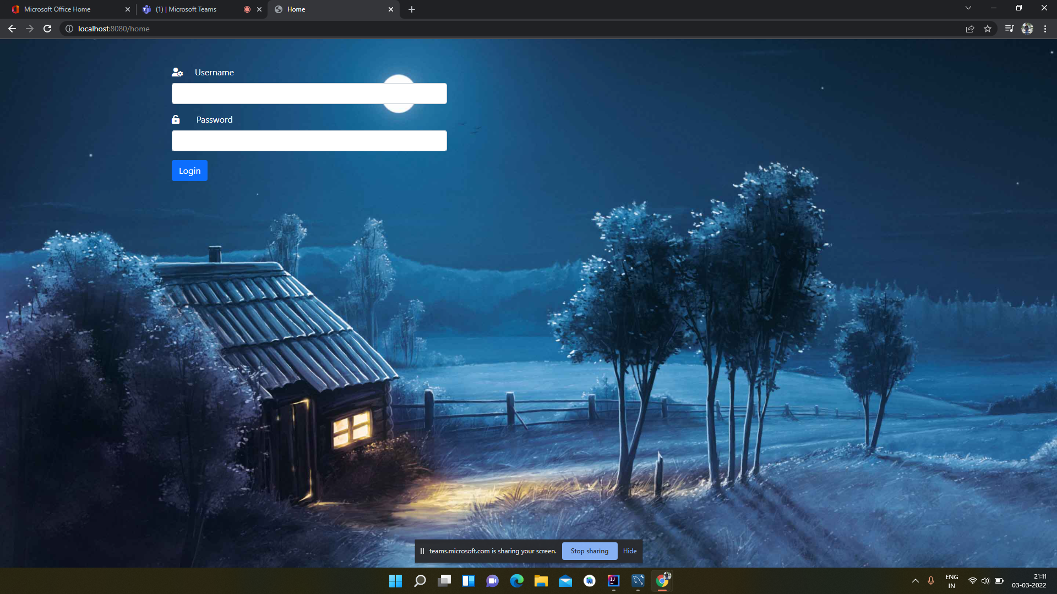
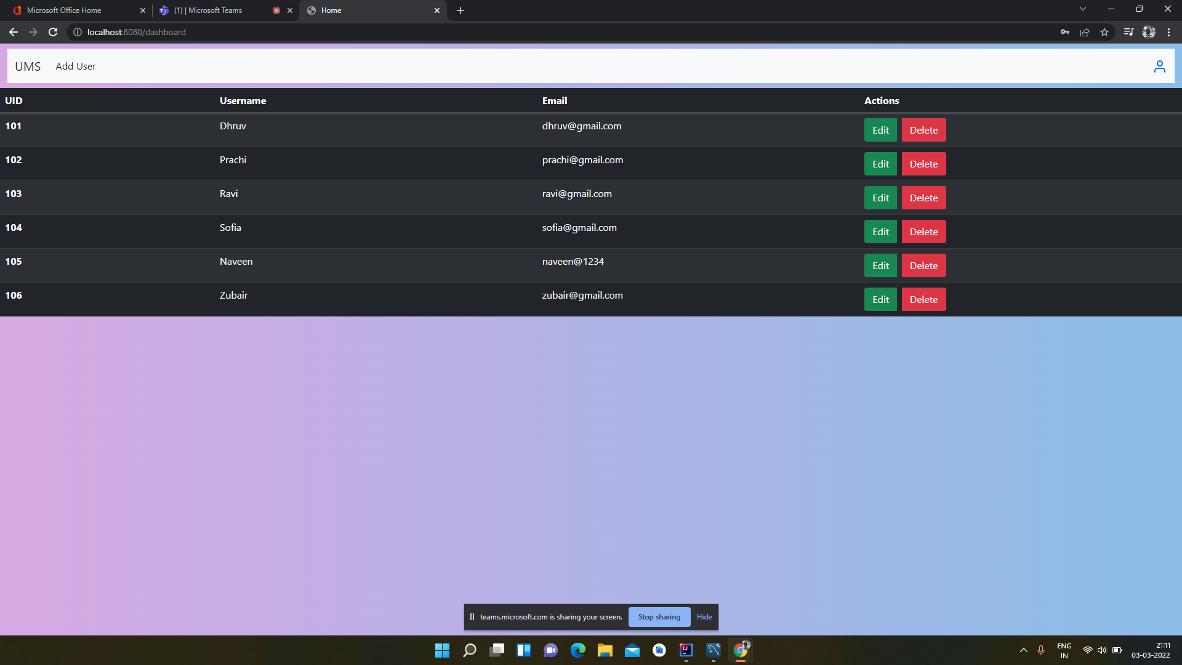

Slide 9
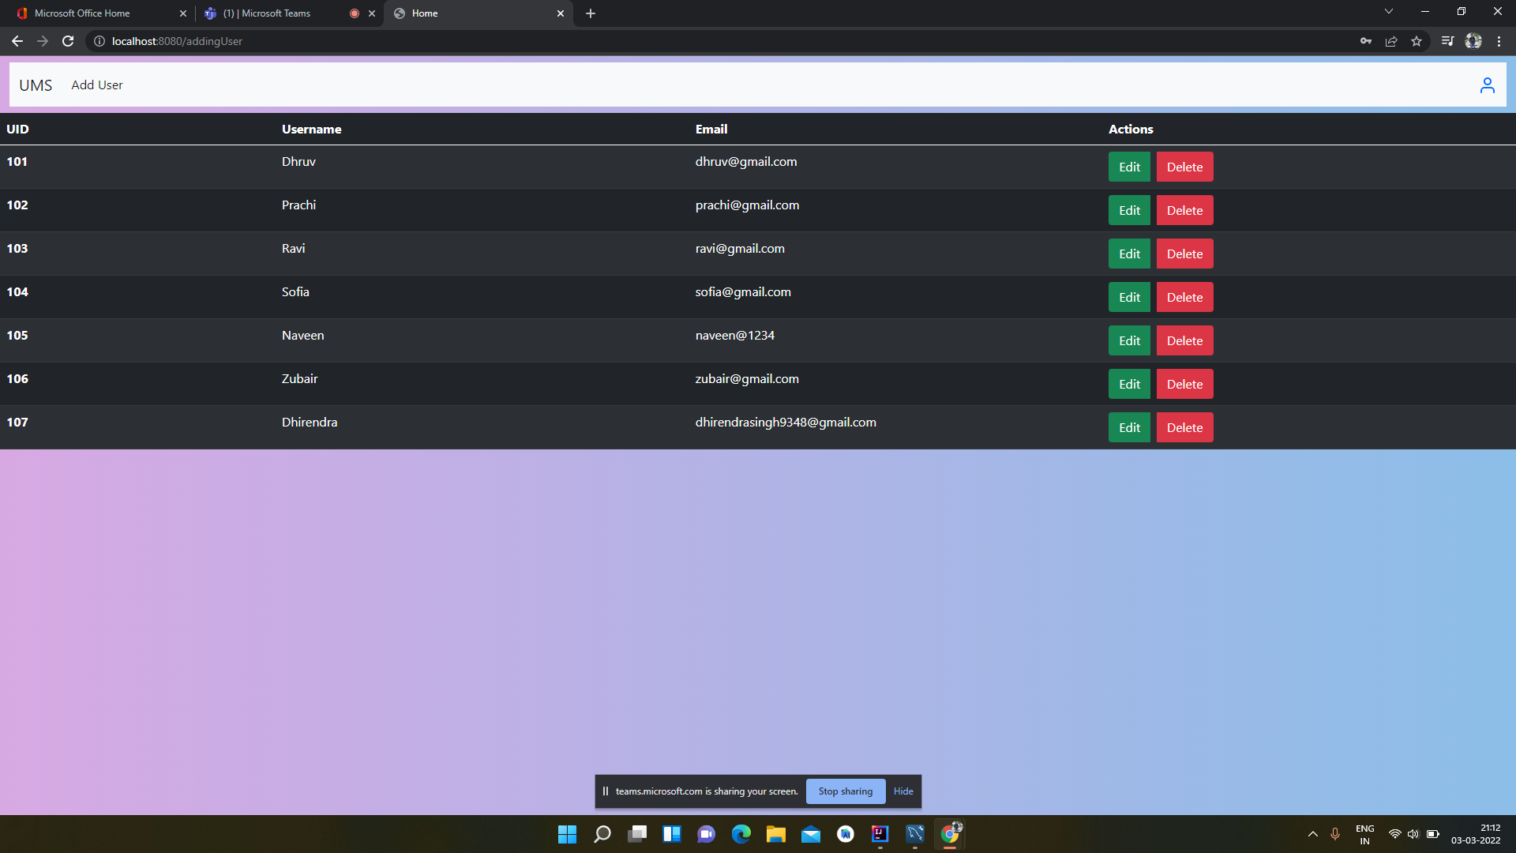
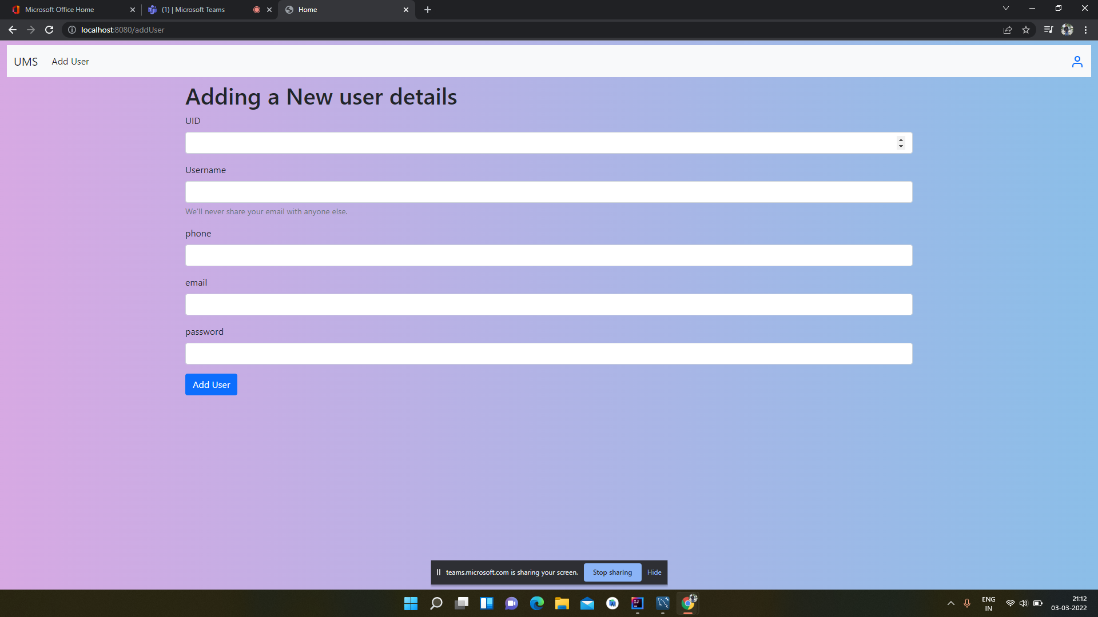

Slide 10

Thank you

